Slide 1
Andreas Lorenz
AWS Engagement Ready Program
Final Project

Slide 2
Application Overview
AutoMotion AG is a mid-sized German automotive parts supplier specializing in just-in-time delivery of custom drivetrain modules for major OEMs (e.g., BMW, VW, Daimler). They operate manufacturing plants in Germany, Hungary, and Mexico, with centralized IT services hosted in an on-premise data center in Stuttgart. The client is a real world example, but it has been anonymized to protect privileged information.

Slide 3
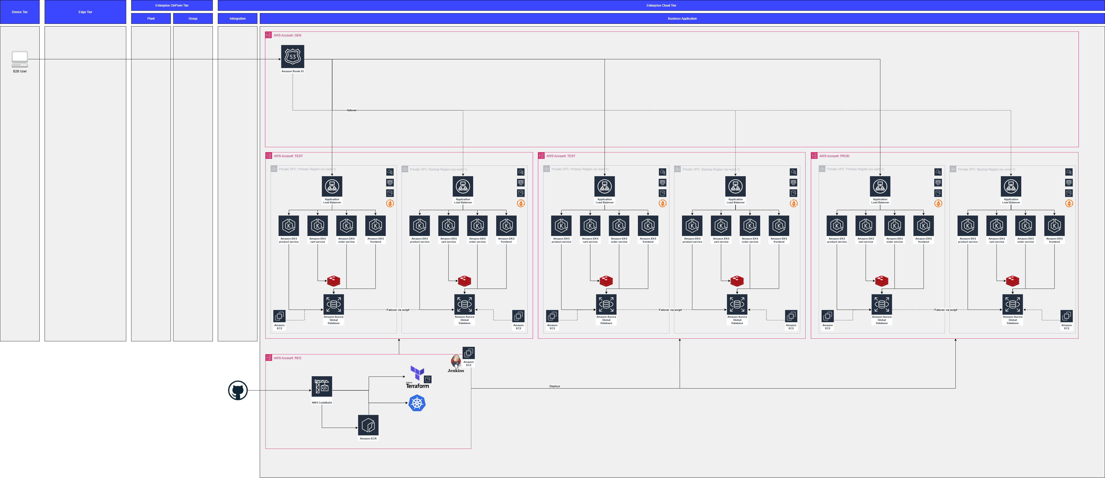
Architecture

Slide 4
Disaster Planning
Resource | Backup Plan | Backup Location | Restore Procedure
Primary Database | Full daily backup + transaction log backups every 15 min | On-prem backup storage + offsite secure vault | Restore full backup, then apply transaction logs up to failure point
Application Server Config | Config files backed up weekly and before changes | Central config management system | Re-deploy config files from backup and validate against latest version
Order Data Files | Incremental backup hourly | Network-attached storage (NAS) | Restore latest incremental backup and verify data integrity
Infrastructure VM Images | Weekly snapshots | Offsite disaster recovery site | Restore VM snapshots and reconfigure network settings

Slide 5
Choosing Compute Service
Task | ECS | EKS | Lambda
Estimate the effort required to refactor the application for the target platform (H, M, L). | M | H | H
Estimate the effort required for the team to learn the new platform (H, M, L). | M | H | M
Estimate the effort required to maintain and administer the target platform over time (H, M, L). | M | H | L
Estimate the monthly cost of running the application using the target platform (ignore database costs). | ~ 2.000 € / month | ~ 3.000 € / month | ~ 1.500 € / month
Which would you recommend? | Balanced choice, good for containerized apps, easier admin than K8s, Easier transformation as existing code can be used

Slide 6
Activity 2: Evaluating Compute Services
Application | EC2 | ECS | EKS | Lambda | Fargate | Elastic Beanstalk
POMS (Plant Order Management System) | Fit – Stateful, legacy-friendly, full control | Best fit – Good container support, but might need stateful services | No fit – Complex orchestration overhead for this app | No fit – Long-running, transactional, not event-driven | Fit – Serverless containers, less management overhead | Fit – Easy deployment of web apps, limited container flexibility
PartsTracker (RFID IoT Processing) | Fit – Possible but more ops overhead | Fit – Containerized microservices | Best fit – Complex, scalable IoT event processing | Fit – Lightweight event-driven parts | Fit – Serverless containers, good for scaling bursts | No fit – Less suited for complex microservices
EDI Gateway | Fit – Stable legacy app, high control | Fit – Containerized, good for APIs | No fit – Simple workload, overhead too high | Best fit – Event-driven, lightweight message processing | Fit – Serverless containers for API scaling | Fit – Quick app deployment, less container control
Quality Control System | Fit – Stateful app, full control | Fit – Container orchestration possible | Best fit – Complex workflows, scaling, orchestration | No fit – Not event-driven or short-lived | Fit – Serverless containers, easier ops | Fit – Managed environment for web apps
Supply Chain Management | Best fit – Stateful, complex enterprise app | Fit – Containerized microservices | Fit – Complex orchestration can help | No fit – Stateful, long-running | Fit – Serverless container flexibility | Fit – Managed platform, less container control
Production Analytics Dashboard | Fit – Full control for compute-heavy workloads | Fit – Containerized API and data processing | Fit – Complex data pipelines | Best fit – Lightweight, event-triggered queries | Fit – Serverless container for bursty load | Fit – Managed app with easy deployment
Maintenance Scheduling System | Fit – Stateful, batch and real-time mix | Fit – Containerized, scalable | Best fit – Orchestration for complex scheduling | No fit – Stateful and long-running | Fit – Serverless containers ease management | Fit – Easy web app hosting
Employee Time Tracking | Fit – Stateful app, full control | Fit – Containerized microservices | No fit – Simpler app, overhead too high | Best fit – Lightweight, event-driven | Fit – Serverless containers for flexibility | Fit – Quick deployment, less control

Slide 7
Activity 2: Evaluating Data Storage Solutions
Application / DB | Object Storage | NAS | Managed Relational DB | Unmanaged Relational DB | Managed NoSQL DB | Data Warehouse
POMS DB (PostgreSQL) | Secondary – Backups and logs storage | Secondary – Shared configs/files | Fit – Transactional core DB | No Fit – High admin effort, risky | No Fit – Needs ACID transactions | No Fit – Optional for analytics
POMS File Share | Secondary – Archives and backups | Fit – Shared config & files | N/A | N/A | N/A | N/A
PartsTracker Event Logs | Fit – Scalable raw event data | Secondary – Possible shared files | Secondary – Metadata storage | No Fit – Difficult scale & ops | Secondary– Best for event ingestion | Secondary – Analytics use
PartsTracker Metadata DB | Secondary – Backup/archive | Secondary – Config/shared files | Fit – Managed metadata DB | No Fit – Ops overhead | Secondary – NoSQL alternative | Secondary – Analytics support
EDI Gateway Messages DB | Secondary – Message archives | Secondary – Shared configs | Fit – Metadata and transactional | No Fit – Risky, high effort | Secondary – Fast lookups for states | Secondary – Optional analytics
EDI Gateway File Share | Secondary – Archives | Fit – Shared configs/files | N/A | N/A | N/A | N/A
Fit: Best fit, recommended primary use
Secondary: Secondary use
No Fit: Not recommended except special cases or legacy reasons
N/A: Not applicable

Slide 8
Activity 3: Security Measures
Data Encryption
In Transit: TLS 1.2+ for all communication (users, app servers, DB)
At Rest:
POMS PostgreSQL encrypted with AWS KMS customer-managed keys (CMKs)
File shares and backups encrypted with AWS-managed keys
Key Management:
Customer-managed keys in AWS KMS for control and auditability
Option for BYOK if compliance demands
Access Control
User Access: Role-Based Access Control (RBAC) with AWS IAM & app roles
Data Access:
External users limited to transactional data via secure APIs
Internal/admin data restricted to privileged users with MFA
Authentication: Integrated company SSO (SAML/OIDC)
Auditing: Continuous monitoring via AWS CloudTrail and logging
Network Security
External Traffic:
Only HTTPS (port 443) and essential service ports allowed via Security Groups
AWS WAF protects frontend from common web threats
Internal Traffic:
Micro-segmentation in VPC separating app, DB, file storage tiers
Security Groups permit only necessary tier-to-tier communication
Firewall Rules & ACLs:
Managed as code (CloudFormation) with automated reviews
Regular audits ensure compliance and operational security

